Slide 1
Bag-of-Words.
Bag-of-Visual-Words.
Radu Ionescu, Prof. PhD.
raducu.ionescu@gmail.com
Faculty of Mathematics and Computer Science
University of Bucharest

Slide 2
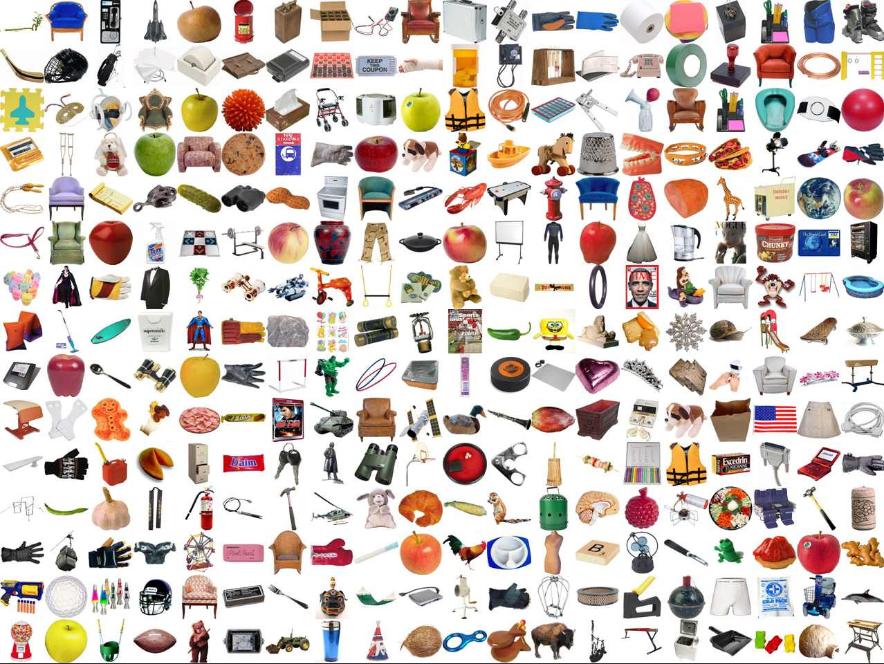
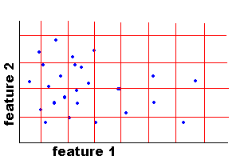
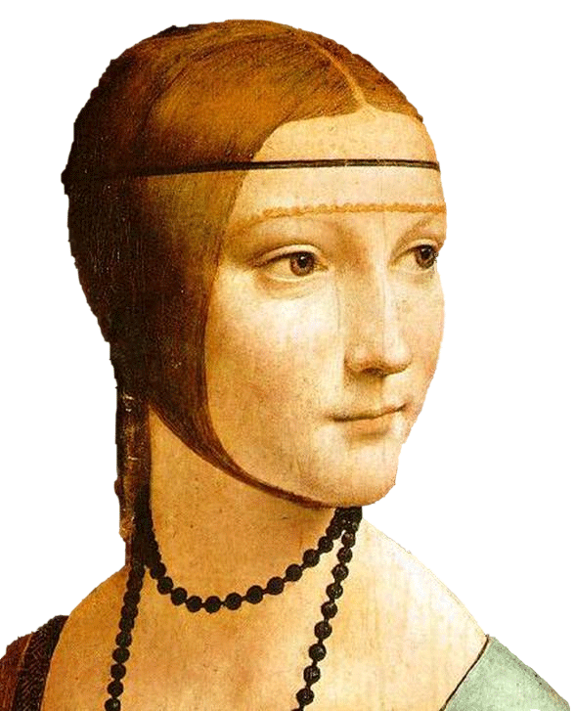
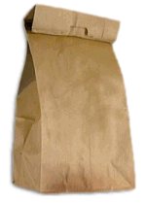
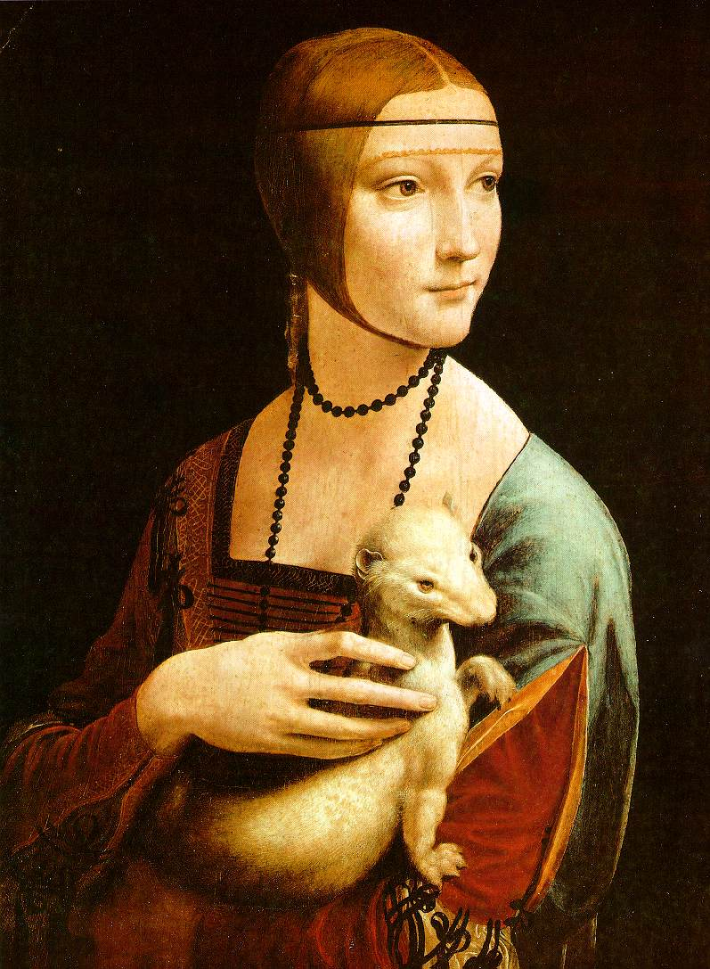
Agenda
Object class recognition
General picture
What is an object class?
Text classification
Bag-of-Words
Image classification
Histograms for feature representation
Bag-of-Visual-Words
c2
c1
Notes:
2

Slide 3
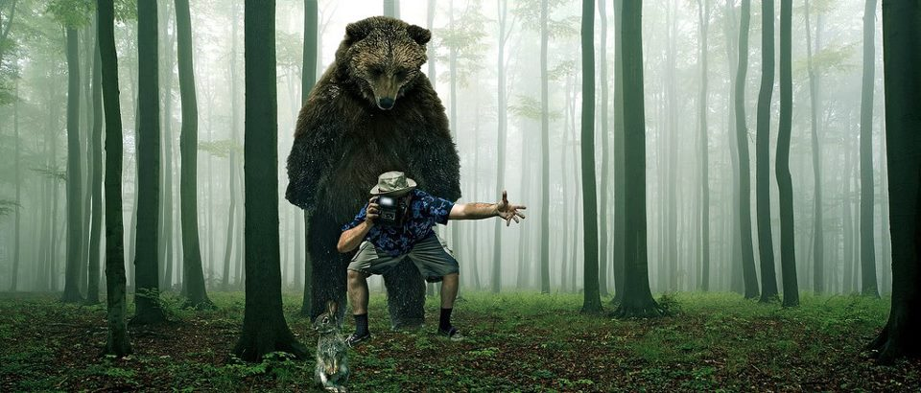
What do you see?
Trees
Bear
Camera
Man
Can I put stuff in it?
Bunny
Grass
Forest
Slide adapted after Derek Hoiem

Slide 4
Is it dangerous?
Is it alive?
How fast does it run?
Has tail?
Slide adapted after Derek Hoiem

Slide 5
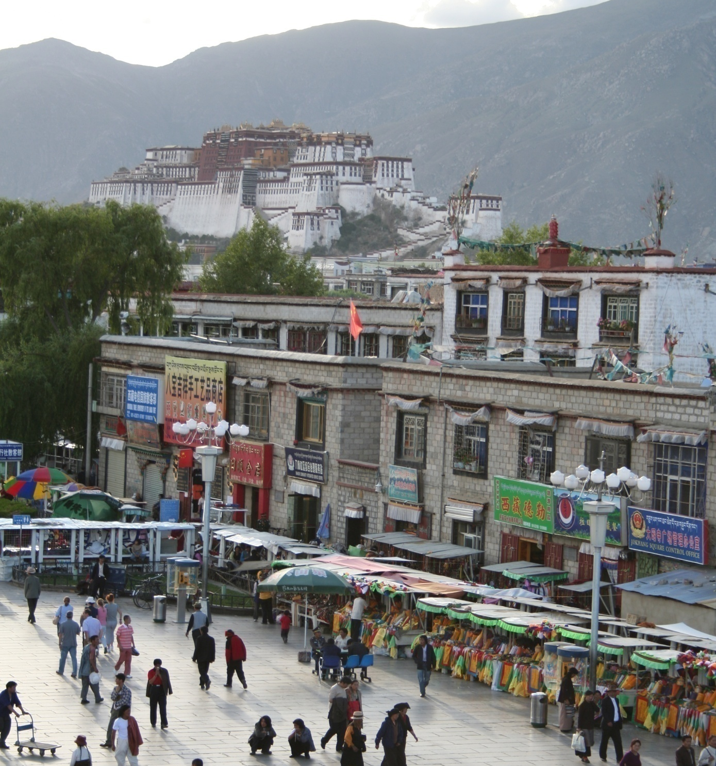
Object class recognition

Slide 6
Verification: Is there a light pole?
Binary answer: Yes/No

Slide 7
Detection: Where is the pole?
Localization

Slide 8
Identification: Which palace?
Instantiation: Potala Palace of Tibet

Slide 9
Region classification
mountain
tree
banner
building
pole
shoppers
people

Slide 10
Scene classification
outdoor
city
…

Slide 11
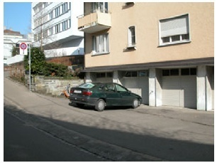
Instance-level Object Recognition
Steven’s car
Slide adapted after K. Grauman

Slide 12
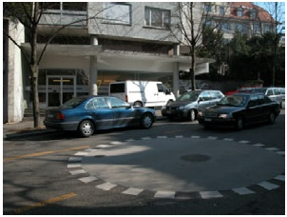
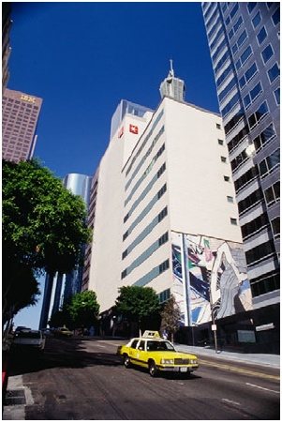
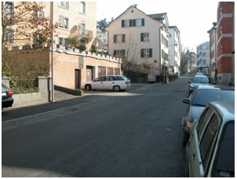
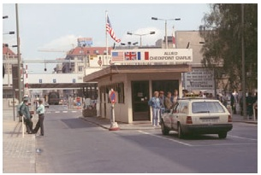
Generic Object Recognition
Recognizing all instances of cars
Slide adapted after K. Grauman

Slide 13
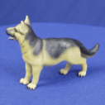
Generic Object Recognition
Problem formulation:
“Given a small number of images with an object class, recognize instances of the object class by assigning the correct object class”
For which object class you can immediately assign an image?
“Max”
Labrador
dog
animal
being
Slide adapted after K. Grauman

Slide 14
Hierarchical organization of object classes (Rosch – 1976)
Base level:
Base-level classes are the highest-level classes in which instances are perceived with similar shape
The highest level for which we can represent the entire class with a single mental image
There is a significant number of common attributes between member pairs
First level understood by children
…
animals
Superior
levels
…
…
mammals
similarity
…
Base level
dog
cat
cow
Labrador
Doberman
Inferior
levels
…
“Max”
…
inferior base superior
Slide adapted after K. Grauman
Notes:
C

Slide 15
Examples of object classes
Slide by Aude Oliva

Slide 16
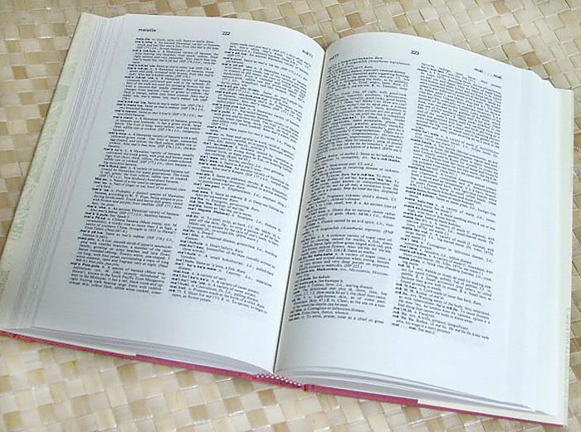

How many object classes?
~10,000 - 30,000
[Biederman, 1987]
Slide adapted after A. Torralba

Slide 17
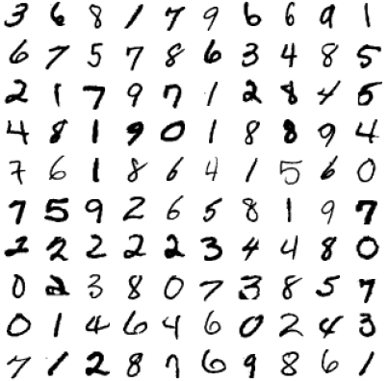
Object class recognition in computer vision – what works well?
OCR – license plate recognition, postal codes, etc.
Slide adapted after S. Lazebnik
Notes:
17

Slide 18
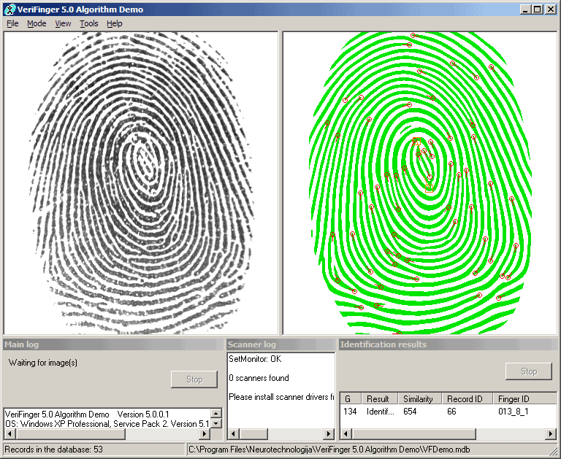
Object class recognition in computer vision – what works well?
OCR – license plate recognition, postal codes, etc.
Fingerprint recognition
Slide adapted after S. Lazebnik
Notes:
18

Slide 19
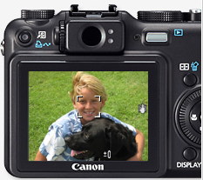
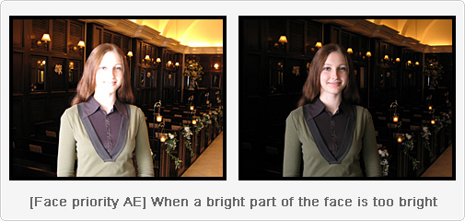
Object class recognition in computer vision – what works well?
OCR – license plate recognition, postal codes, etc.
Fingerprint recognition
Face detection
Slide adapted after S. Lazebnik
Notes:
19

Slide 20
Object class recognition in computer vision – what works well?
OCR – license plate recognition, postal codes, etc.
Fingerprint recognition
Face detection
Textured object recognition (CD / book covers)
Slide adapted after S. Lazebnik
Notes:
20

Slide 21

Finding visually-similar objects
Notes:
21

Slide 22
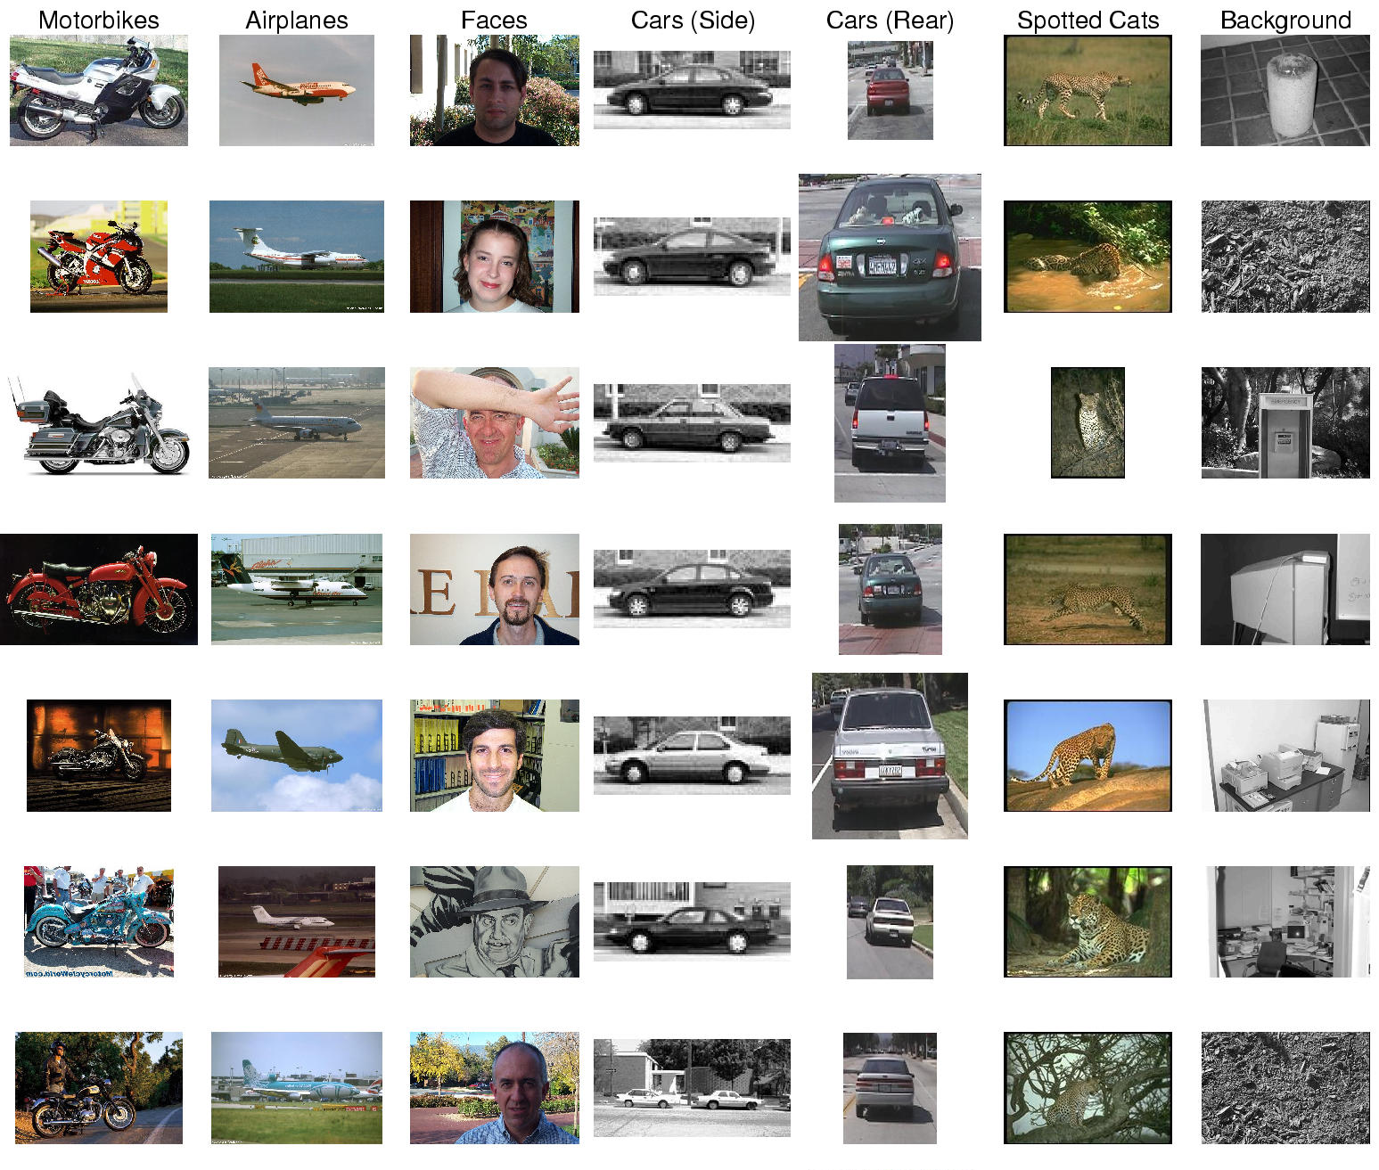
Object recognition in computer vision
Care
(side)
Car
(back)
Motorbike
Plane
Face
Cheetah
Background
Problems:
Intra-class variability
Inter-class similarity (car, truck, bus)
Variable object sizes
Background confusion

Slide 23
Image classification

Slide 24
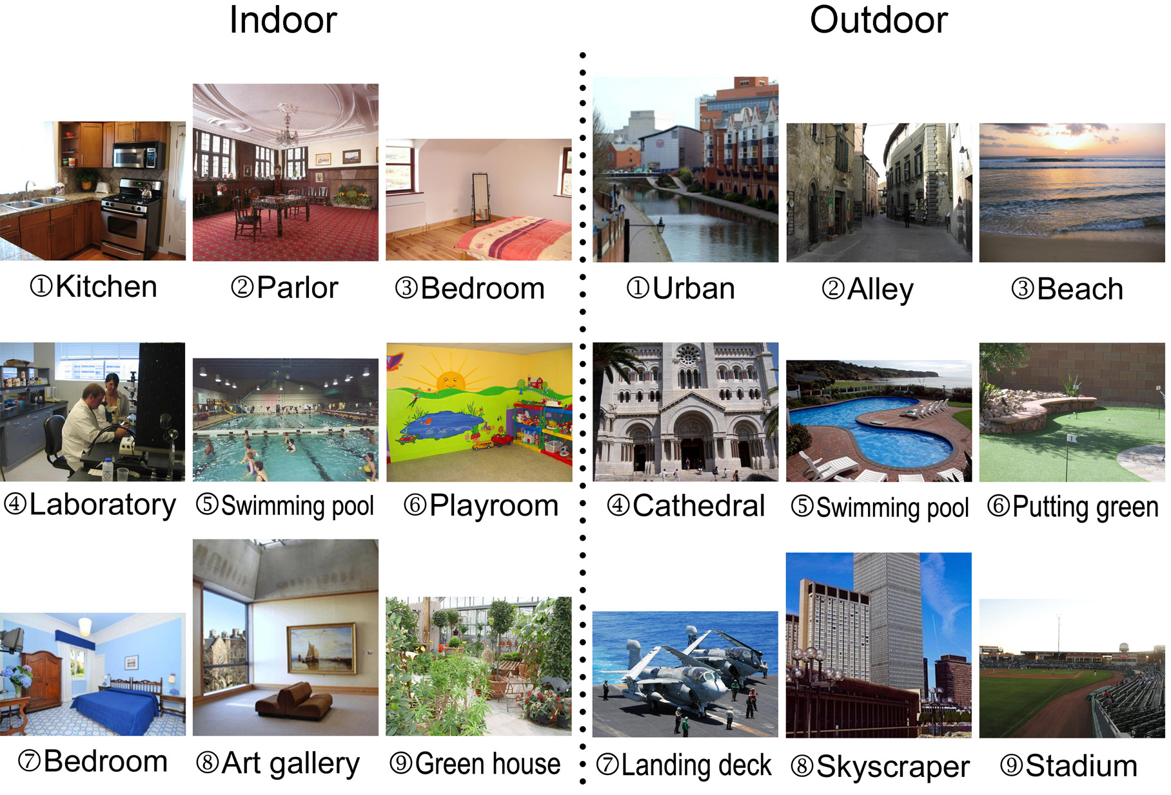

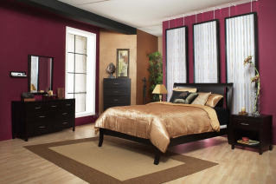
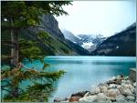
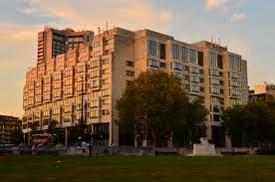
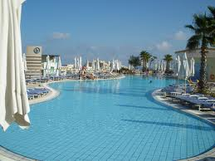
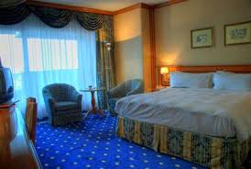
Example: 2 classes - indoor/outdoor
Indoor – examples
Outdoor - examples
Classification = assign labels (indoor, outdoor) to new examples
outdoor
outdoor
indoor
Test images:

Slide 25
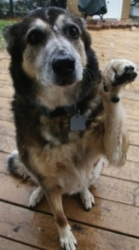
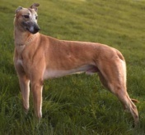
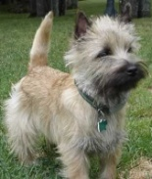
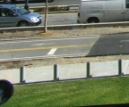

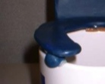
Supervised Learning
Color Histogram
x
x
x
x
x
Texton Histogram
o
+
+
x
o
x
= class
label
o
o
o
Other features
x
x
Examples:
- negative
- positive
Features for image representation
Classifier
= visual descriptors of image content
Slide adapted after D. Hoiem

Slide 26
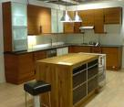
Training stage
Labels for training examples
Training examples
Learning
Image features
Train a classifier
Trained classifier
x
x
x
x
x
x
x
Testing
x
o
x
o
x
o
o
o
o
o

Slide 27
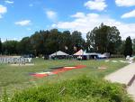
Inference stage
Learning
Labels for training examples
Training examples
Image features
Train a classifier
Trained classifier
Inference
Image features
Trained classifier
Prediction:
Outdoor
Test image

Slide 28
Feature extraction
Learning
Labels for training examples
Training examples
Image features
Train a classifier
Trained classifier

Slide 29
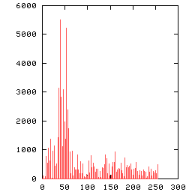
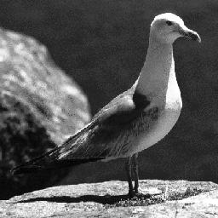
Histograms
Measure feature distribution:
count how many points “fall” in each bin
normalization? sum = 1
color, texture, etc…
Space Shuttle Cargo Bay
Slide adapted after D. Kauchak

Slide 30
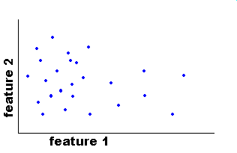
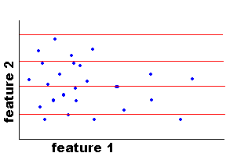
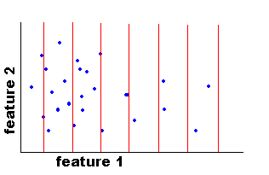
Histograms
feature 2
feature 2
feature 1
feature 1
feature 2
feature 2
feature 1
feature 1
Joint Histogram
Needs a lot of data for a good estimation of the distribution
#intervals 1 * #intervals 2
Independent histogram
Needs independent features
More data points per interval than joint histogram

Slide 31
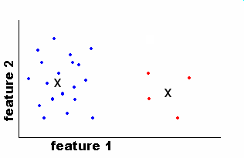
Histograms
Clustering
feature 2
feature 2
EASE Truss Assembly
feature 1
feature 1
19
0.83
#points
4
normalization
0.17
index
of cluster
centers
index
of cluster
centers
Space Shuttle Cargo Bay
Use the same cluster centroids in all images!
Slide adapted after D. Kauchak

Slide 32
Computing distance between histograms
Euclidean distance (L₂):
Chi-square distance:
Histogram intersection distance:
Nearest color histograms (based on Chi-square distance)

Slide 33
Histograms: implementation details
Data grouping
Intervals: fast, applicable for small images
Clustering: slow, but applicable for large images
Distance metrics between histograms
Euclidean, intersection => fast to compute
Chi-square => better accuracy
Try out other distance metrics
Few Intervals
Few points for estimation
Coarse representation
Many Intervals
Many points for estimation
Fine representation
Slide adapted after D. Hoiem

Slide 34
Text classification

Slide 35
Bag-of-words
The bag-of-words model works as follows:
1) Given a set of text documents, all the words from the set are added in a vocabulary
2) A bag-of-words representation is built for each document, by counting down the occurrences of each word in the vocabulary

Slide 36
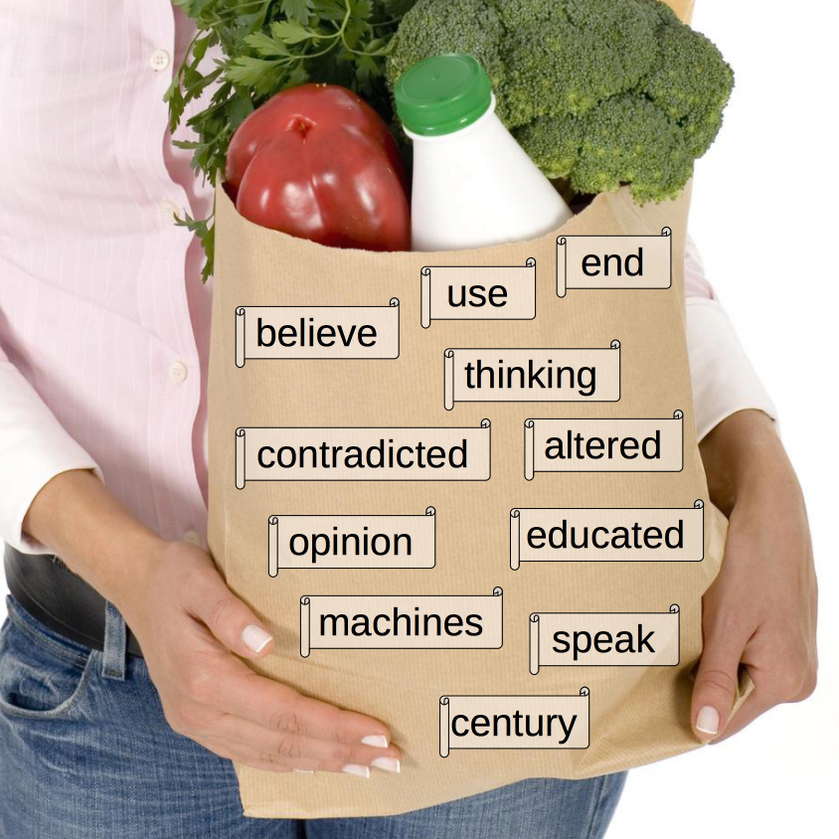
Bag-of-words
“I believe that at the end of the century the use of words and general educated opinion will have altered so much that one will be able to speak of machines thinking without expecting to be contradicted.” – Alan Turing
Note that stopwords are usually removed!

Slide 37
Bag-of-words
For a search query such as:

Slide 38
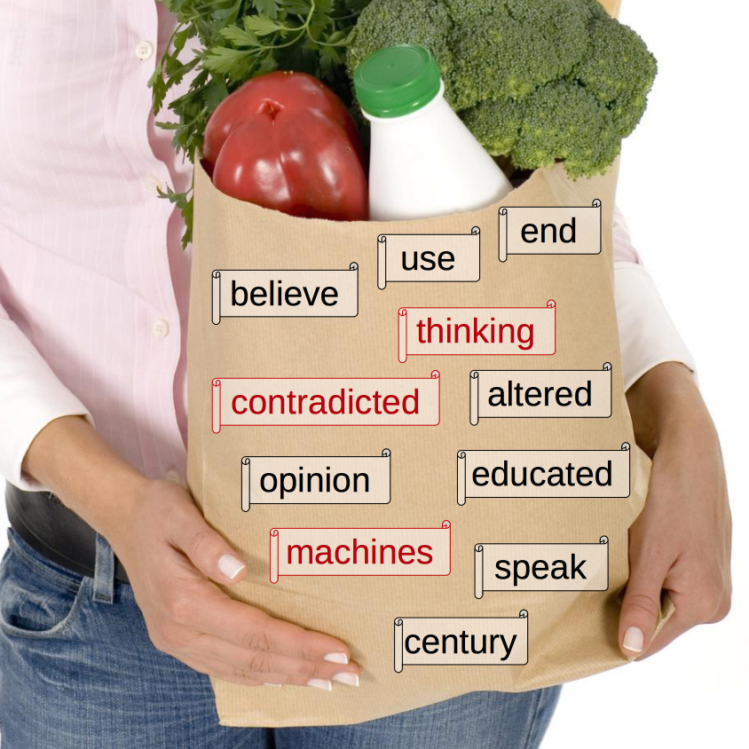
Bag-of-words
For a search query such as:
The system can quickly figure out which documents contain the query terms:

Slide 39
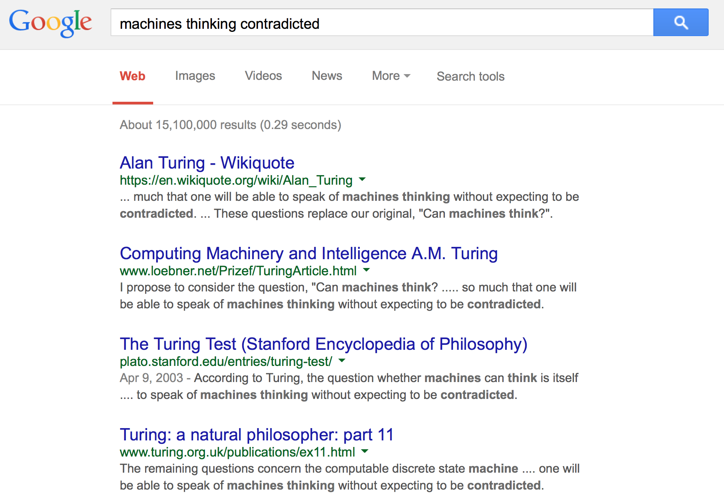
Bag-of-words
And return appropriate results:

Slide 40
Binary term-document incidence matrix
Sec. 6.2
Each document is represented by a binary vector $∈{\{0,1\}}^{\left|V\right|}$

Slide 41
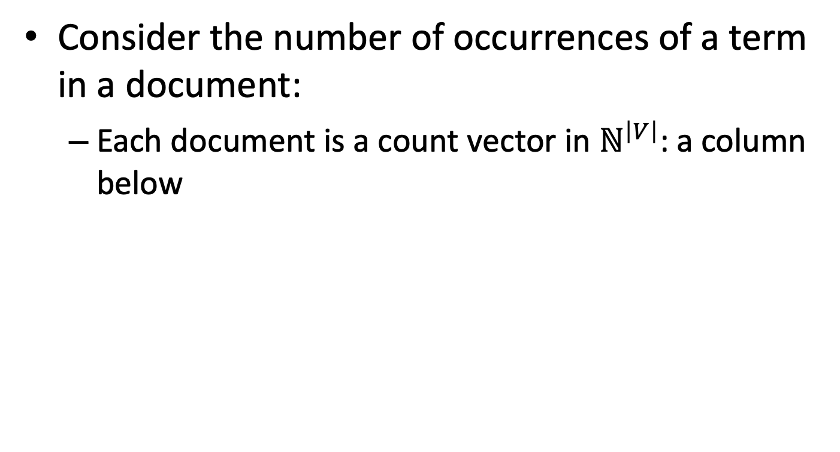
Term-document count matrices
Sec. 6.2
Consider the number of occurrences of a term in a document:
Each document is a count vector in $ℕ^{\left|V\right|}$: a column below

Slide 42
Bag-of-words
Vector representation doesn’t consider the ordering of words in a document.
Problem: “John is quicker than Mary” and “Mary is quicker than John” have the same vectors.
Locations of words can be partially recovered by using:
word n-grams
spatial pyramids [Ionescu & Popescu, Springer, ACVPR, 2016]

Slide 43
The Vector-Space Model
Assume t distinct terms remain after indexing
We call them index terms or the vocabulary
These “orthogonal” terms form a vector space:
Dimension = t = |vocabulary|
Each term, i, in a document or query, j, is given a real-valued weight, w_{ij.}
Both documents and queries are expressed as t-dimensional vectors:
d_{j} = (w_{1j} , w_{2j} , …, w_{tj})

Slide 44
Graphic Representation
Example:
D₁ = 2T₁ + 3T₂ + 5T₃
D₂ = 3T₁ + 7T₂ + T₃
Q = 0T₁ + 0T₂ + 2T₃
T₃
5
D₁ = 2T₁+ 3T₂ + 5T₃
Q = 0T₁ + 0T₂ + 2T₃
2
3
T₁
D₂ = 3T₁ + 7T₂ + T₃
Is D₁ or D₂ more similar to Q?
How to measure the degree of similarity? Distance? Angle? Projection?
7
T₂

Slide 45
Document Collection
A collection of n documents can be represented in the vector space model by a term-document matrix
An entry in the matrix corresponds to the “weight” of a term in the document
Zero means the term has no significance in the document or it simply doesn’t exist in the document
T₁ T₂ …. T_{t}
D₁ w₁₁ w₂₁ … w_{t1}
D₂ w₁₂ w₂₂ … w_{t2}
: : : :
: : : :
D_{n} w_{1n} w_{2n} … w_{tn}

Slide 46
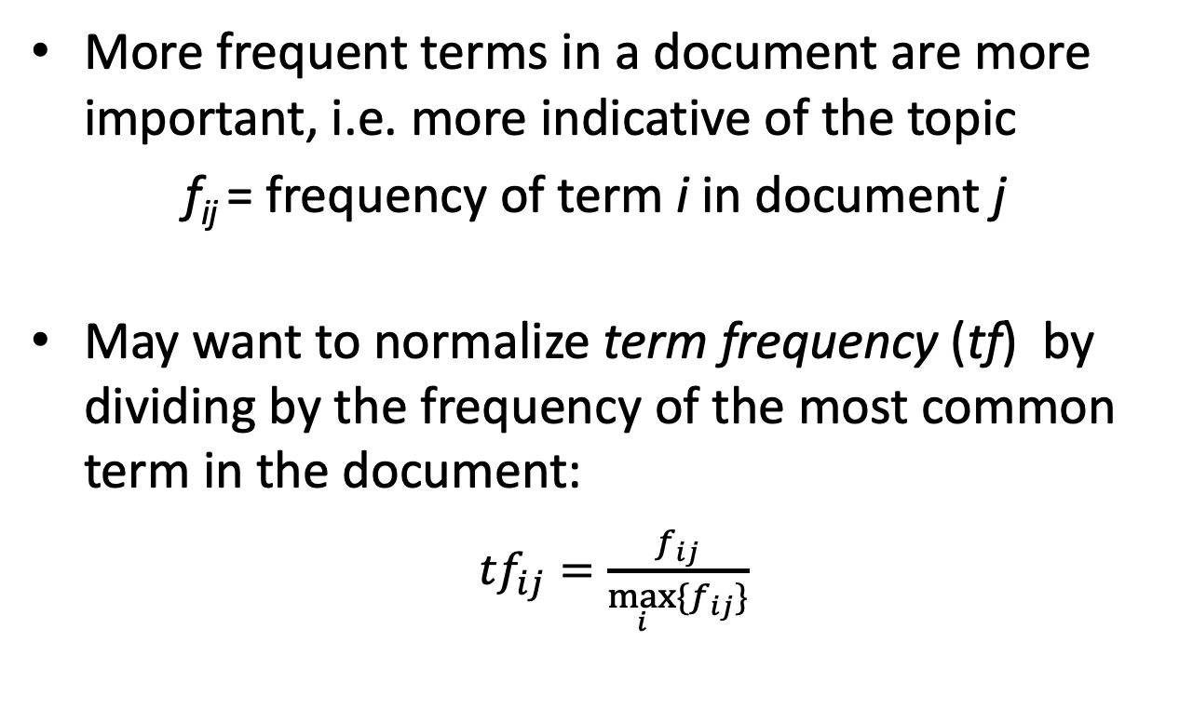
Term Frequency (tf)
More frequent terms in a document are more important, i.e. more indicative of the topic
f_{ij} = frequency of term i in document j
May want to normalize term frequency (tf) by dividing by the frequency of the most common term in the document:
${tf}_{ij}=\frac{f_{ij}}{\max_{i}{\{f_{ij}\}}}$

Slide 47
Term frequency (tf)
We want to use tf when computing query-document match scores. But how?
Raw term frequency is not what we want:
A document with 10 occurrences of the term is more relevant than a document with 1 occurrence of the term
But not 10 times more relevant
Relevance does not increase proportionally with term frequency.

Slide 48
Document frequency (df)
Sec. 6.2.1
Rare terms are more informative than frequent terms
E.g.: stop words such as the, an, of, in
Consider a term in the query that is rare in the collection (e.g., brewery).
A document containing this term is very likely to be relevant to the query “brewery”.
We want a high weight for rare terms like brewery!

Slide 49
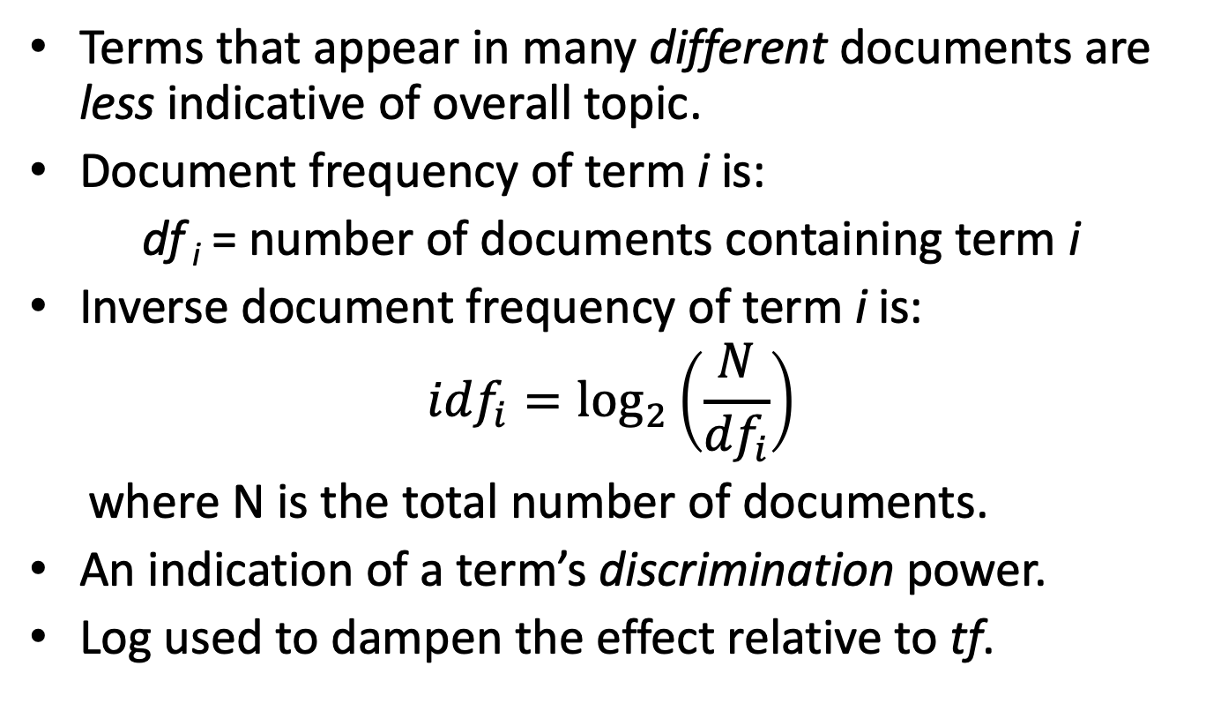
Inverse Document Frequency (idf)
Terms that appear in many different documents are less indicative of overall topic.
Document frequency of term i is:
df _{i} = number of documents containing term i
Inverse document frequency of term i is:
$${idf}_{i}=\log_{2}\left(\frac{N}{{df}_{i}}\right)$$
where N is the total number of documents.
An indication of a term’s discrimination power.
Log used to dampen the effect relative to tf.

Slide 50
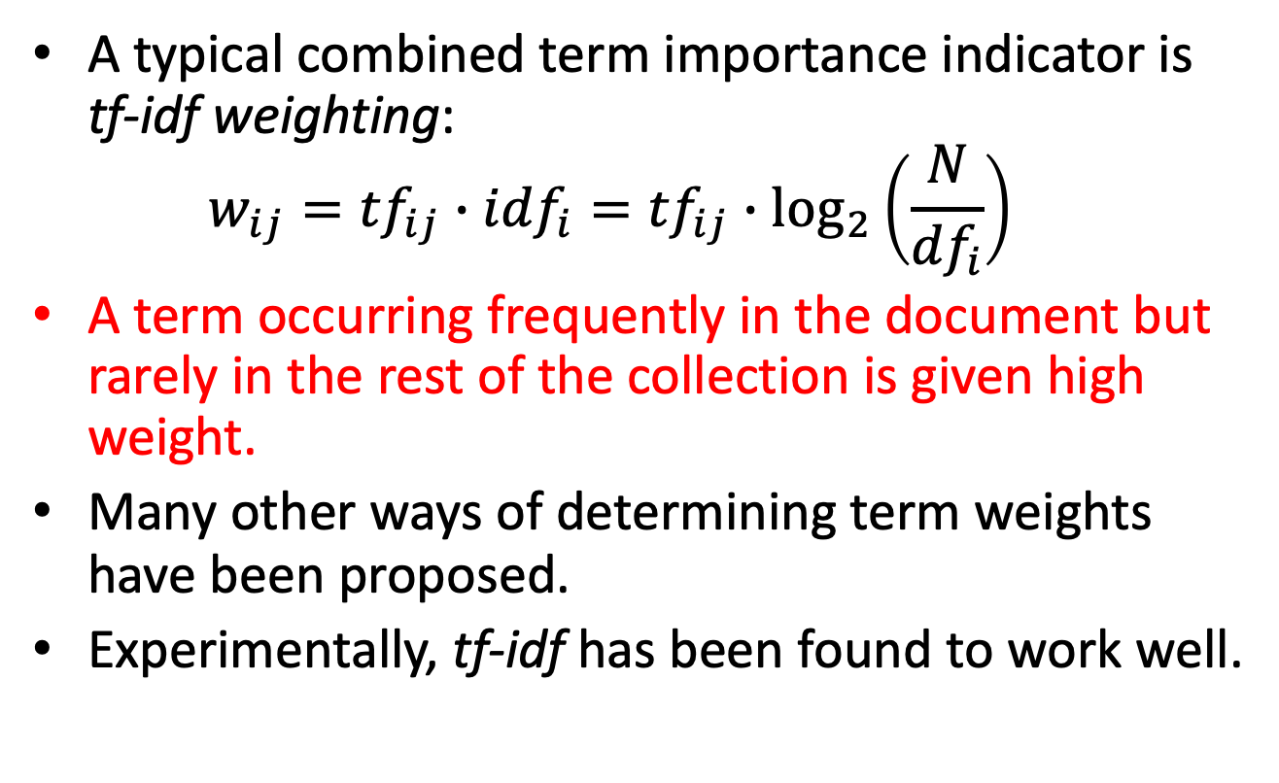
TF-IDF Weighting
A typical combined term importance indicator is tf-idf weighting:
$$w_{ij}={tf}_{ij}∙{idf}_{i}={{tf}_{ij}∙log}_{2}\left(\frac{N}{{df}_{i}}\right)$$
A term occurring frequently in the document but rarely in the rest of the collection is given high weight.
Many other ways of determining term weights have been proposed.
Experimentally, tf-idf has been found to work well.

Slide 51
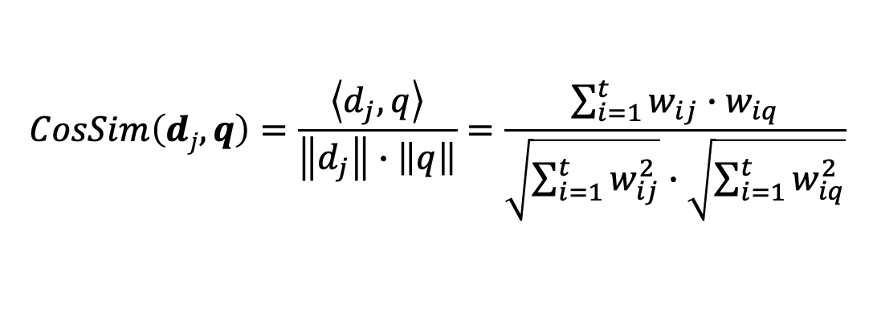
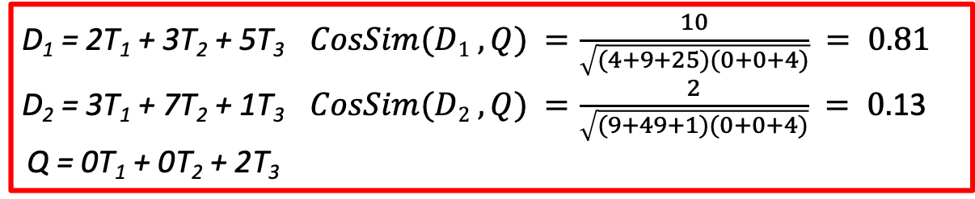
Cosine Similarity Measure
Cosine similarity measures the cosine of the angle between two vectors
Inner product normalized by the vector lengths:
t₃
θ₁
$$CosSim\left(dj, q\right)=\frac{\left\langle d_{j},q\right\rangle }{\left\|d_{j}\right\|∙\left\|q\right\|}=\frac{\sum_{i=1}^{t}{w_{ij}∙w_{iq}}}{\sqrt{\sum_{i=1}^{t}{w_{ij}^{2}}}∙\sqrt{\sum_{i=1}^{t}{w_{iq}^{2}}}}$$
D₁
Q
θ₂
t₁
t₂
D₂
D₁ = 2T₁ + 3T₂ + 5T₃ $CosSim(D1 , Q) =\frac{10}{\sqrt{(4+9+25)(0+0+4)}} = 0.81$
D₂ = 3T₁ + 7T₂ + 1T₃ $CosSim(D2 , Q) =\frac{2}{\sqrt{(9+49+1)(0+0+4)}} = 0.$13
Q = 0T₁ + 0T₂ + 2T₃
D₁ is 6 times better than D₂ using cosine similarity but only 5 times better using inner product.

Slide 52
Object class recognition

Slide 53
Bag-of-visual-words
A similar model for image classification and image retrieval would be very useful
But how can we define words in images?
Words are the atoms that form coherent text
Atomic repetitive patterns can be observed in images as well

Slide 54
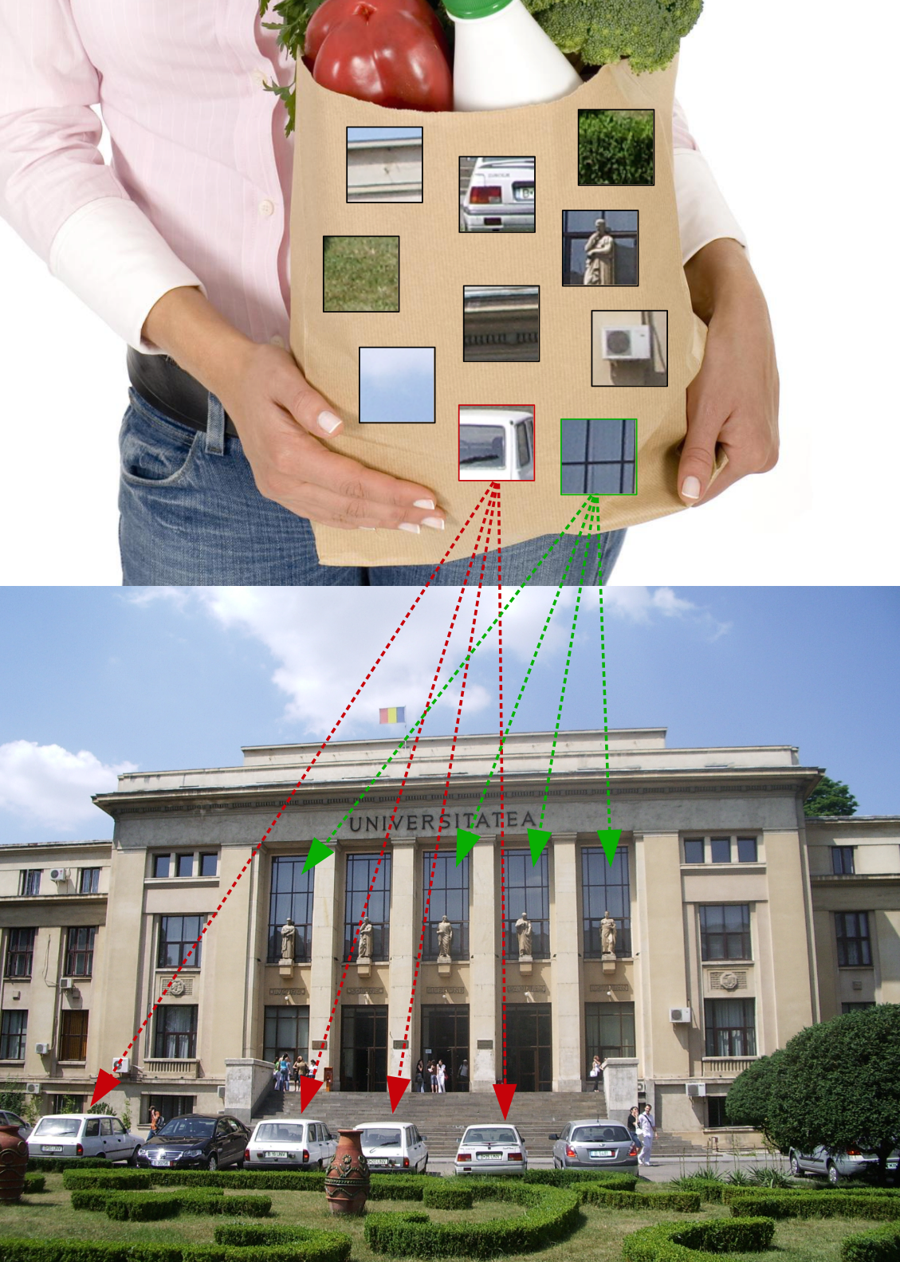

Slide 55
Bag-of-visual-words
Atomic repetitive patterns can be observed in images as well
However these atomic patterns are not identical in all locations in the image, because of various transformations

Slide 56
Bag-of-visual-words
A visual word is defined as a group of similar (but not necessarily identical) local image patterns
Visual words are usually obtained by vector quantization, e.g. k-means clustering

Slide 57
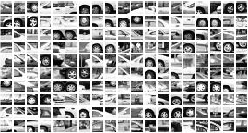
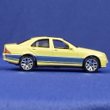















Visual word vocabulary
…
Notes:
- The vocabulary is in the red rectangle

Slide 58
Object
Bag-of-visual-words
Slide adapted after L. Fei-Fei
Notes:
Bovw – construitea unui vocabular de cuvinte vizuale prin folosirea unei metode de clustering pentru a grupa descriptori locali din imagine
Inspirat din procesarea limbajului natural , regasirea informatiei

Slide 59

Bag-of-words-like models: texture representation
Idea explored for the first time in texture representation
Textons = centroids of clusters obtained by clustering filter responses applied over images
Representation/description of textures based on the distribution of textons (prototype elements)
Slide adapted after J. Sivic

Slide 60

Texture recognition
regular
stochastic
Texture samples (Wikipedia)

Slide 61






Texture recognition
Texture is characterized by the repetition of basic elements, textons
We represent textures through histograms of textons (we count how many textons of certain type appear in each image)

Slide 62




Texture recognition
histogram
Universal texton dictionary
Julesz, 1981; Cula & Dana, 2001; Leung & Malik 2001; Mori, Belongie & Malik, 2001; Schmid 2001; Varma & Zisserman, 2002, 2003; Lazebnik, Schmid & Ponce, 2003

Slide 63


Visual words
Slide adapted after J. Sivic

Slide 64
Visual words
Used to describe object appearance
Object appearance can vary a lot, even for the same class of objects
Local appearance (of object parts) has smaller variation
Ideally: visual word = object part

Slide 65




Bag-of-visual-words
Image set
Extract features from each image
Learn a visual vocabulary = codebook
Assign each feature to the nearest “visual word” from the codebook
Represent images based on a histogram of visual word frequencies

Slide 66

2. Feature extraction
+ + + + + + + + + + + +
Keypoints on a grid, points of interest or random points in the images
+ + + + + + + + + + + +
+ + + + + + + + + + + +
Describe the patch (small image region) centered on each keypoint
+ + + + + + + + + + + +
+ + + + + + + + + + + +
+ + + + + + + + + + + +
+ + + + + + + + + + + +
+ + + + + + + + + + + +
+ + + + + + + + + + + +
Slide adapted after J. Sivic

Slide 67
2. Feature extraction
+ + + + + + + + + + + +
…
+ + + + + + + + + + + +
+ + + + + + + + + + + +
+ + + + + + + + + + + +
Patch descriptors are
n-dimensional vectors
+ + + + + + + + + + + +
…
+ + + + + + + + + + + +
+ + + + + + + + + + + +
+ + + + + + + + + + + +
+ + + + + + + + + + + +
…
…
Slide adapted after J. Sivic

Slide 68
2. Feature extraction
Commonly used descriptors:
SIFT – Scale Invariant Feature Transform
HoG – Histogram of Oriented Gradients (next)

Slide 69

Edges and derivatives
An edge is the place where there is a large variation of the intensity function
intensity function (along the red line)
derivative of the
intensity function
image
edges = extreme points
of the derivative
Slide adapted after S. Lazebnik

Slide 70
Computing derivatives through convolution
For a function f(x,y), the partial derivative with respect to x is:
In the discrete case (images formed of pixels) we can approximate the derivative using finite differences:
Can we implement this with a filter? How does the filter look like?

Slide 71
Computing derivatives through convolution
X
Hint: filters are rotated by 180º during convolution
y
convolution
0
0
0
?
1
-1
0
0
0
0

Slide 72

Partial derivatives of an image
?
1 -1
-1 1
1 -1
or
Which image shows the variantion on x / y?
(check out the convolution filters)
Slide adapted after S. Lazebnik

Slide 73
Sobel filters
There are filters that can better approximate the derivatives
Sobel filters compute the partial derivatives taking into account larger vicinities
-1 0 1
-2 0 2
-1 0 1
2 1
0 0 0 -1 -2 -1
Vertical Sobel filter for computing partial derivative
Horizontal Sobel filter for computing partial derivative

Slide 74



Computing image gradient
-1 | 0 | 1
-2 | 0 | 2
-1 | 0 | 1
-1 | -2 | -1
0 | 0 | 0
1 | 2 | 1
M_{x} =
M_{y} =
image f
values = 0
large values
small values

Slide 75


Computing image gradient
-1 | 0 | 1
-2 | 0 | 2
-1 | 0 | 1
-1 | -2 | -1
0 | 0 | 0
1 | 2 | 1
M_{x} =
M_{y} =
image f
Gradient magnitude

Slide 76



Computing image gradient
-1 | 0 | 1
-2 | 0 | 2
-1 | 0 | 1
-1 | -2 | -1
0 | 0 | 0
1 | 2 | 1
M_{x} =
M_{y} =
image f
Gradient orientation

Slide 77

Computing image gradient
-1 | 0 | 1
-2 | 0 | 2
-1 | 0 | 1
-1 | -2 | -1
0 | 0 | 0
1 | 2 | 1
M_{x} =
M_{y} =
image f
[0, 90º]
[90º,180º]
[0, 90º]
[90⁰, 180º]
[180º, 270º]
[270º, 360º]
[270º,360º]
[180º,270º]

Slide 78
Computing image gradient
Gradient magnitude

Slide 79



Image Gradient: Summary
Image Gradient:
The gradient shows the direction of the largest intensity variation
What is the link between the direction of the gradient and that of the edge?
The gradient direction is perpendicular on the edge direction
Gradient direction is given by:
An edge is characterized by the gradient magnitude:
or

Slide 80



HoG for human detection
Histogram of oriented gradients
Overlapped blocks
Image
Gradient
Local normalization
Cells
Split window into cells
For each cell, compute a histogram of oriented gradients
Group cells into blocks
HoG = histograms of blocks
Navneet Dalal and Bill Triggs,
Histograms of Oriented Gradients for Human Detection, CVPR05
http://lear.inrialpes.fr/people/triggs/pubs/Dalal-cvpr05.pdf
Slide adapted after K. Grauman

Slide 81




HoG for human detection

Slide 82
HoG for human detection
resize window to 128 x 64 pixels
divide image into cells of 8 x 8 pixels
compute image gradient (for each pixel we have orientation and magnitude)
for each cell compute a histogram of oriented gradients
group cells into blocks
HoG = a descriptor obtained by concatenating histograms of 105 blocks
Block 2
Block 1
Block 3
64
128
Block 105
Navneet Dalal and Bill Triggs,
Histograms of Oriented Gradients for Human Detection, CVPR05
http://lear.inrialpes.fr/people/triggs/pubs/Dalal-cvpr05.pdf
Slide adapted after K. Grauman

Slide 83

Original image
Compute gradients
Contrastive normalization using block overlaps
HoG over window
Human/
Not human
Normalize
HoG on each cell
Linear classifier
Slide adapted after N. Dalal

Slide 84





Original image
Compute gradients
Contrastive normalization using block overlaps
HoG over window
Human/
Not human
Normalize
HoG on each cell
Linear classifier
Tested with
RGB
grayscale
Gamma normalization (transforming intensity values/colors)
without normalization
squared root
logarithm
better performance with RBG
Original image
grayscale
red
green
blue
better performance with square root
Slide adapted after N. Dalal

Slide 85






Original image
Compute gradients
Contrastive normalization using block overlaps
HoG over window
Human/
Not human
Normalize
HoG on each cell
Linear classifier
centered
diagonal
non-centrered
corrected cubic
Sobel
Slide adapted after N. Dalal

Slide 86


Original image
Compute gradients
Contrastive normalization using block overlaps
HoG over window
Human/
Not human
Normalize
HoG on each cell
Linear classifier
Histograms of Oriented Gradients
Orientation-based: 9 intervals for orientations between [0º, 180º]
Cell-based
- The contribution of each pixel is directly proportional with gradient magnitude
Slide adapted after N. Dalal

Slide 87



Original image
Compute gradients
Contrastive normalization using block overlaps
HoG over window
Human/
Not human
Normalize
HoG on each cell
Linear classifier
Histograms of Oriented Gradients
Trilinear interpolation:
linear based on orientation
bilinear based on cells
Slide adapted after N. Dalal

Slide 88


Original image
Compute gradients
Contrastive normalization using block overlaps
HoG over window
Human/
Not human
Normalize
HoG on each cell
Linear classifier
Trilinear interpolation example:
linear based on orientation:
Θ = 85º
distances from centers 70º, 90º are 15º, 5º
5/20 = ¼ contribution in interval centered in 70º
15/20 = ¾ contribution in interval centered in 90º
soft-assignment
bilinear based on cells:
distances from centers: left – 2, right – 6, top – 2, down – 6
partial contributions: 6/8 = ¾ - left, 2/8 = ¼ right
partial contributions: 6/8 = ¾ - top, 2/8 = ¼ down
total contributions:
6/8 * 6/8 = 9/16 left – top
6/8 * 2/8 = 3/16 left – down
2/8 * 6/8 = 3/16 right – top
2/8 * 2/8 = 1/16 right -down
Orientarea gradienților
Slide adapted after N. Dalal

Slide 89

Original image
Compute gradients
Contrastive normalization using block overlaps
HoG over window
Human/
Not human
Normalize
HoG on each cell
Linear classifier
Block = group of 2x2 cells
Block histogram = concatenate histograms of the 4 cells inside the block (histograms are normalized with respect to the entire block)
A cell belongs to multiple blocks
Normalization
there are different approaches
Slide adapted after N. Dalal

Slide 90


Original image
Compute gradients
Contrastive normalization using block overlaps
HoG over window
Human/
Not human
Normalize
HoG on each cell
Linear classifier
Concatenated block histograms
# orientations
HoG size = 15 x 7 x 4 x 9 = 3780
# blocks
# cells in block
Slide adapted after N. Dalal

Slide 91

Original image
Compute gradients
Contrastive normalization using block overlaps
HoG over window
Human/
Not human
Normalize
HoG on each cell
Linear classifier
Visualizing the descriptor
Slide adapted after N. Dalal

Slide 92

HoG + SVM
Visualization
Test image
HoG descriptor
HoG descriptor with
orientations weighted
as positive by the SVM

Slide 93






HoG + SVM
Visualization

Slide 94




HoG for other object class

Slide 95
3. Learning the visual vocabulary
…
Slide adapted after J. Sivic

Slide 96
3. Learning the visual vocabulary
…
Clustering
Slide adapted after J. Sivic

Slide 97
3. Learning the visual vocabulary
Visual vocabulary
…
Clustering
Slide adapted after J. Sivic

Slide 98

K-means clustering
Want to minimize the sum of Euclidean distances between feature vectors x_{i} and the nearest cluster centroids m_{k}:
$$L\left(X,M\right)=\sum_{k=1}^{K}{\sum_{{x_{i}∈C}_{k}}{{(x_{i}−m_{k} )}^{2}}}$$
Algorithm (Expectation-Maximization):
1. Initialize the K cluster centroids randomly
2. Iterate until clusters converge:
a. Label each vector based on the nearest cluster centroid
b. Recompute the centroid of each cluster = mean of all feature vectors assigned to a cluster

Slide 99
K-means clustering – 1.

Slide 100
K-means clustering – 1.

Slide 101
K-means clustering – 2.a.

Slide 102
K-means clustering – 2.b.

Slide 103
K-means clustering – 2.b

Slide 104
K-means clustering – 2.a

Slide 105
K-means clustering – 2.b.

Slide 106
K-means clustering – 2.b.

Slide 107
K-means clustering – 2.a.

Slide 108
K-means clustering – 2.b.

Slide 109
K-means clustering – 2.b.

Slide 110
K-means clustering – 2.a.

Slide 111
K-means clustering – 2.b.

Slide 112
K-means clustering – 2.b.

Slide 113
K-means clustering – 2.a.

Slide 114
K-means clustering - Output

Slide 115
Visual word vocabulary
…
Notes:
- The vocabulary is in the red rectangle

Slide 116

Visual word vocabulary
…

Slide 117




Limitations of bag-of-visual-words
The representation does not take into account the location of words in the image
Advantages?
Problems?
Slide adapted after V. Ferrari

Slide 118




Location of features in the image
These 3 images have the same histogram

Slide 119

Spatial pyramid
Compute histogram for each sub-region (bin)

Slide 120
Spatial pyramid

Slide 121


Spatial pyramid
level 0
Slide adapted after S. Lazebnik

Slide 122




Spatial pyramid
level 0
level 1
Slide adapted after S. Lazebnik

Slide 123
















Spatial pyramid
level 0
level 1
level 2
Slide adapted after S. Lazebnik

Slide 124


